Slide 1
Search jobs
First – I have a template for the front-end – it needs to be updated with angular code to make dynamic
Second – I have started working on backend api in node.js already
Third – the following slides show what needs to be created or added BUT the look of the font and type of font and widgets used should be what is in the template – the aesthetics should be the existing template – what I am creating is not the ‘look’ but what needs to be done

Slide 2
The next slides are about admin log in

Slide 3
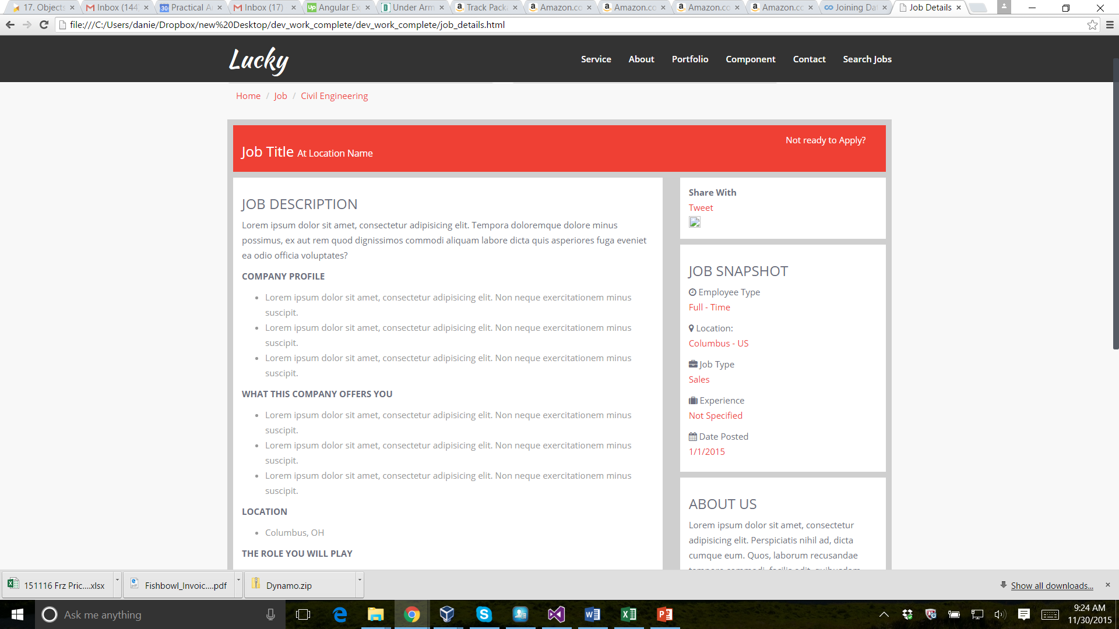
admin
Search jobs
Need to add admin button should be same font type as other navigation buttons

Slide 4
admin
Search jobs
User Name and Password will be in dynamodb database
User name
password
Submit
The font and color scheme should follow the same theme that exists in the template – what I create in the ppt is just to show what needs to be created

Slide 5
The next slides are about editing an existing job

Slide 6
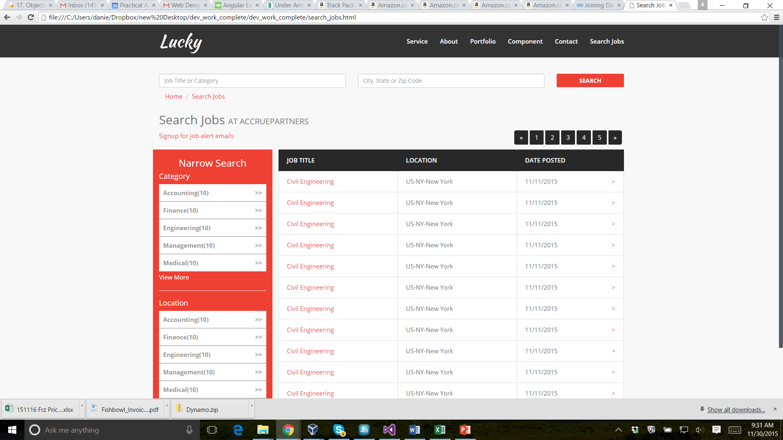
admin
Search jobs
Search
New Job
When you log in this is what the admin and the user will both see this page – but the admin will see the “new job” button
But the next slides are as if you were an admin
Press button as admin

Slide 7
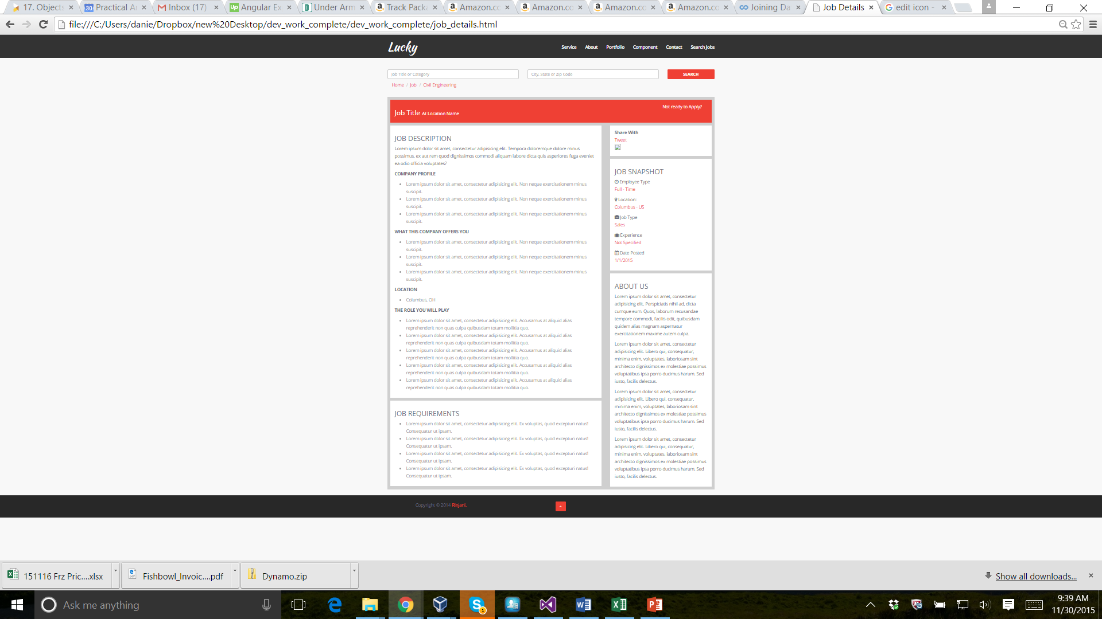
admin
Search jobs
I zoomed out so you can see the whole form…please look at the next slide as to how to build the form.. Each section will have an ‘edit’ icon so the end user can write in the information …but we will also need a rich text editor so the admin can enter text of different size and thickness etc…

Slide 8
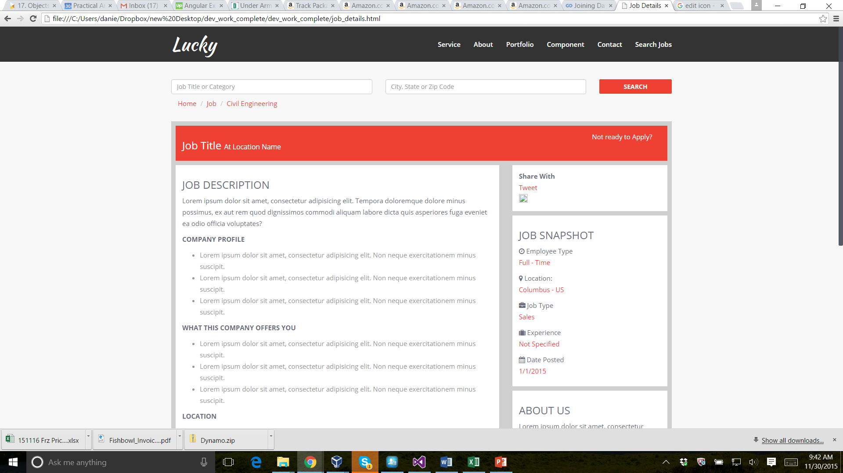

admin
Search jobs
Add buttons
Save Changes
Delete
Job
There should be edit icon that is clickable – once you click it – it should open a rich text editor for each section
How do we deal with social media – if there is a lot of time to do this – we will just not have this section to start?
How do we deal with icons?

Slide 9
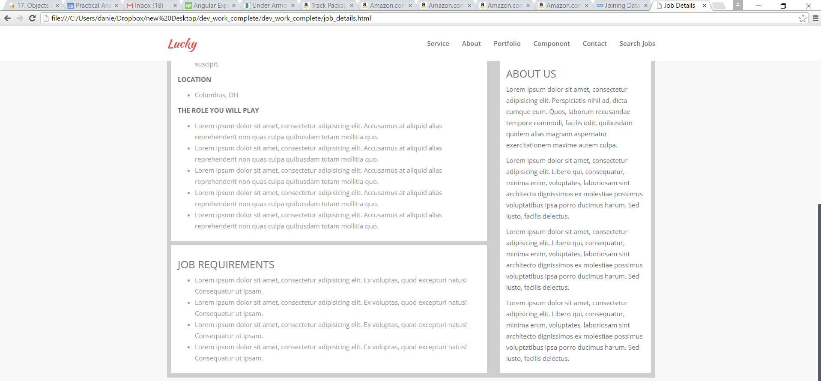
admin
Search jobs
This should be driven from dynamo db
This is a text box and when press enter it should be add to tag list
This should just show the list of what tags the admin put on the job
Select Category
Add Tag
Tag List

Slide 10
Next slides
The process of adding a “new” job

Slide 11
admin
Search jobs
Search
New Job
Press button for ‘new job”
See next slide

Slide 12
admin
Search jobs
Save Changes
Delete
Job
It’s the same screen as the other process of editing an existing job – we just need to create a unique id for the job though

Slide 13
The next slides are based on a user looking for a job (i.e. a NON ADMIN person)

Slide 14
admin
Search jobs
Search
No ‘new job”
button

Slide 15
admin
Search jobs
Save Changes
Delete
Job
These buttons should not show up
Non of the edit icons should show up

